Slide 1
Lecture 8 Distinguishing between the Needs of the Self and the Body

Slide 2
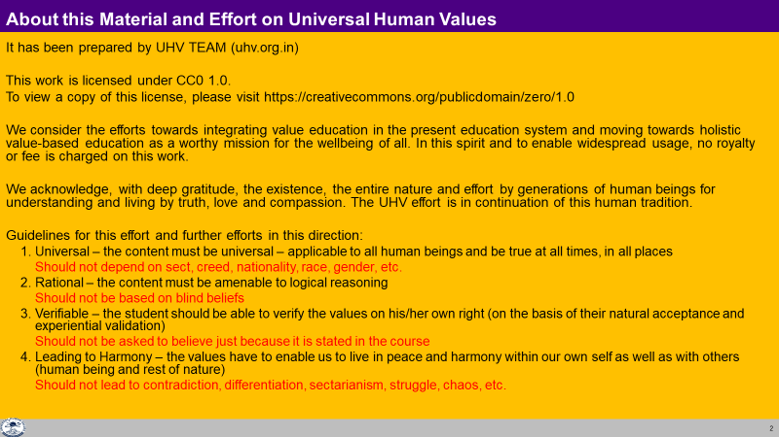

Slide 3
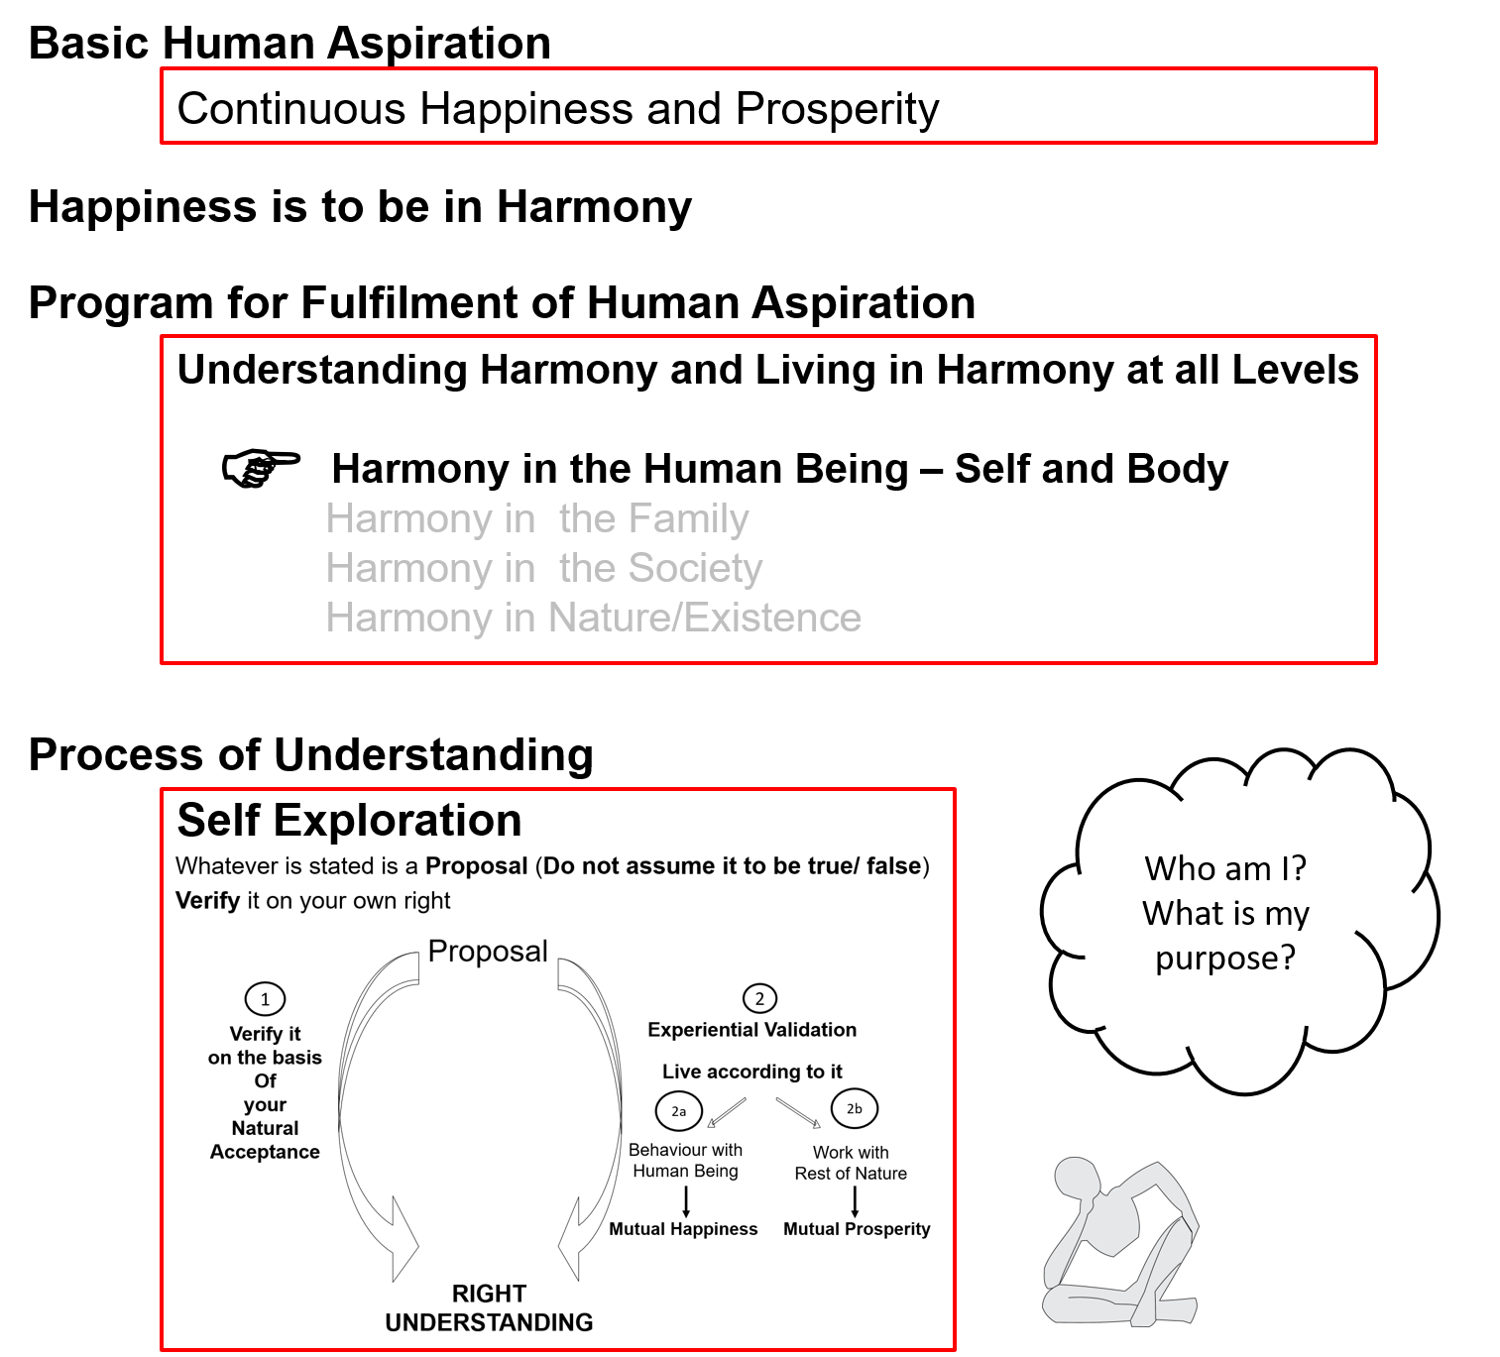

Slide 4
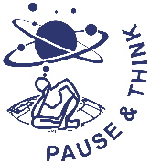
Human Being Ekkuo | Self eSa | Body “kjhj
Need vko';drk | Happiness (e.g. Respect) lq[k ¼tSls lEeku½ | Physical Facility (e.g. Food) lqfo/kk ¼tSls Hkkstu½
In Time dky esa | Continuous fujUrj | Temporary lkef;d
In Quantity ek=k esa | Qualitative (is Feeling) xq.kkRed ¼Hkko gS½ | Quantitative (Required in Limited Quantity) Ekk=kRed ¼lhfer ek=k esa½
Fulfilled By iwfrZ ds fy, | Right Understanding & Right Feeling lgh le>] lgh Hkko | Physio-chemical Things HkkSfrd&jklk;fud oLrq
Activity fØ;k | Desire, Thought, Expectation… bPNk] fopkj] vk”kk--- | Eating, Walking… [kkuk] pyuk---
In Time dky esa | Continuous fujUrj | Temporary lkef;d
Response | Knowing, Assuming, Recognising, Fulfilling tkuuk] ekuuk] igpkuuk] fuokZg djuk | Recognising, Fulfilling igpkuuk] fuokZg djuk
 | Consciousness pSrU; | Material tM+
Co-existence
lgvfLrRo

Slide 5
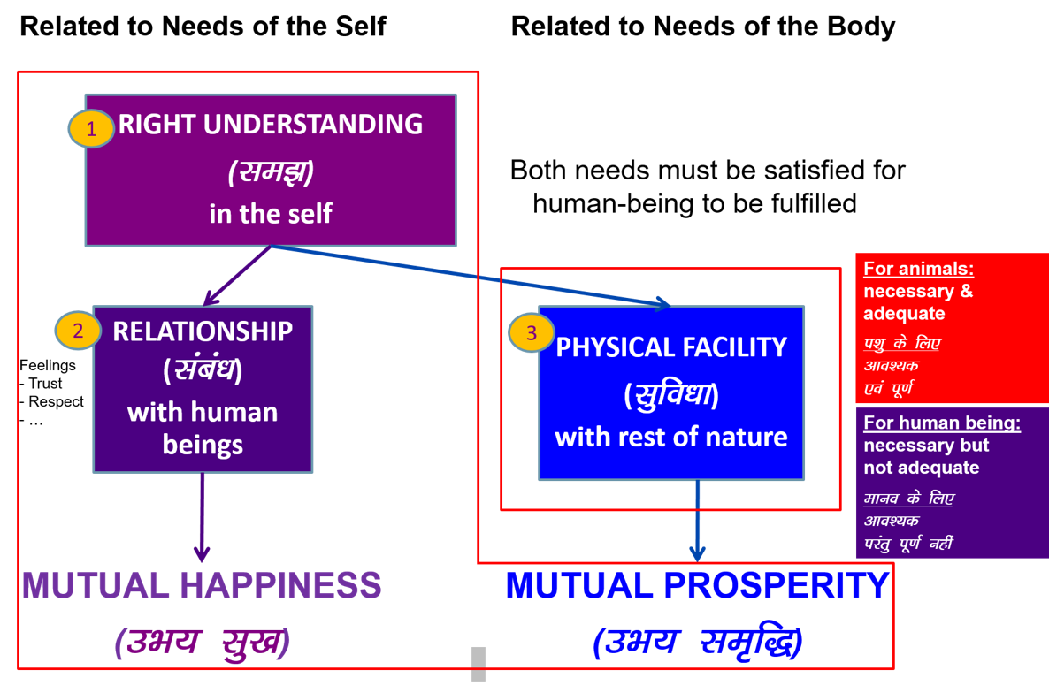

Slide 6
the
Human Being Ekkuo | Self eSa | Body “kjhj
Need vko';drk | Happiness (e.g. Respect) lq[k ¼tSls lEeku½ | Physical Facility (e.g. Food) lqfo/kk ¼tSls Hkkstu½
In Time dky esa | Continuous fujUrj | Temporary lkef;d
In Quantity ek=k esa | Qualitative (is Feeling) xq.kkRed ¼Hkko gS½ | Quantitative (Required in Limited Quantity) Ekk=kRed ¼lhfer ek=k esa½
Fulfilled By iwfrZ ds fy, | Right Understanding & Right Feeling lgh le>] lgh Hkko | Physio-chemical Things HkkSfrd&jklk;fud oLrq
Co-existence
lgvfLrRo
Consciousness
Need of the Self = Continuous happiness = Need of consciousness
Fulfilled by = Right Understanding and Right Feeling in the Self = Activities of consciousness
(can not be fulfilled by material)
(The need of consciousness is fulfilled by activities of consciousness)
Notes:
Fulfilled by
Flower to Father – flower is only a symbol. Feeling is primary. Feelings ka bandh mein band kar rakha hai – feelings ka aadan-pradan nahin hota. Feelings ka exchange bhi sukhi hone ka tareeka hai, yeh dhyan mein nahin aaya rahta
One cant fulfill the other
Exclusive dress – attention neq respect. Dress se attention bhar mil paata hai

Slide 7
the
Human Being Ekkuo | Self eSa | Body “kjhj
Need vko';drk | Happiness (e.g. Respect) lq[k ¼tSls lEeku½ | Physical Facility (e.g. Food) lqfo/kk ¼tSls Hkkstu½
In Time dky esa | Continuous fujUrj | Temporary lkef;d
In Quantity ek=k esa | Qualitative (is Feeling) xq.kkRed ¼Hkko gS½ | Quantitative (Required in Limited Quantity) Ekk=kRed ¼lhfer ek=k esa½
Fulfilled By iwfrZ ds fy, | Right Understanding & Right Feeling lgh le>] lgh Hkko | Physio-chemical Things HkkSfrd&jklk;fud oLrq
Co-existence
lgvfLrRo
Material
Need of the Body = Physical facility* = Material in nature
Fulfilled by = Physio-chemical things = Material in nature
(The need of material is fulfilled by material)
*physical facility is required for nurturing, protection and right utilization of the Body
Notes:
Fulfilled by
Flower to Father – flower is only a symbol. Feeling is primary. Feelings ka bandh mein band kar rakha hai – feelings ka aadan-pradan nahin hota. Feelings ka exchange bhi sukhi hone ka tareeka hai, yeh dhyan mein nahin aaya rahta
One cant fulfill the other
Exclusive dress – attention neq respect. Dress se attention bhar mil paata hai

Slide 8
Gross Misunderstanding
Human Being Ekkuo | Self (I) eSa | = | Body “kjhj
Need vko’;drk | Respect lEeku | = | Physical Facility (Eg. Food, Clothes) lqfo/kk (tSls&Hkkstu] diM+k)
 | Continuous fujUrj | = | Unlimited vlhfer
Feeling of Deprivation
I don’t have enough!
Accumulation = unlimited?
Effort for Physical Facility
by any means?
Accumulation of Physical Facility – Unlimited!
Lqfo/kk laxzg & vlhfer!
Loop
Check if you
are caught up
In this loop
Deprivation
nfjnzrk

Slide 9
Sum Up
Human being is a co-existence of Self (consciousness) and Body (material)
The needs of the Self and the Body are of two different types, and they have to be fulfilled separately
The need of the Self is continuous happiness
The need of the Body is physical facility
The need of consciousness is fulfilled by activity of consciousness (it can not be fulfilled by material)
The needs of material is fulfilled by material
A gross misunderstanding is to assume the human being to be the Body (material), and to assume that all human needs can be fulfilled by material – this leads to deprivation, exploitation, etc

Slide 10
Practice Session after Lecture 8
1. Take the list of desires you made in PS2. Update it if required. Now classify the desires as being related to the need of the Self or need of the Body. If a desire appears to be related to both (needs of the Self and needs of the Body), look for the purpose, and split it into two or more sub-desires until you are able to see clearly whether the sub-desire is related to the need of the Self or the need of the Body.
From this exercise,
Find out at least two key distinguishing features between the needs of the Self and the needs of the Body.
Roughly what percentage of your desires is related to the needs of the Self and what percentage is related to the needs of the Body?

Slide 11
Practice Session after Lecture 8…
2. Make a list of your activities from morning till night. Some of these are activities going on in you (the Self), some activities are going on in your Body and some activities involve both you (the Self) as well as your Body. Classify the list of activities in these three categories (see table, below).
Write down your observations regarding:
The activities of the Self which do not involve the Body. Can you see that these activities are continuous?
Activities of the Body. Can you see that they involve some internal organs of the Body (like the heart and blood vessels)? Can you see that these activities are discontinuous or cyclic?
Activities that involve both, the Self as well as the Body (like climbing a staircase). In such activities, try to identify the role of the sense organs as well as the work organs.
Activity | In the Self | In the Body | Involving both the Self and the Body
Running |  |  | I made the decision to run. The Body is running
Eating |  |  | I made the decision to eat. The Body is eating. The Body is getting the nutrition and I am getting the taste
Thinking | I am thinking. My body is not involved
Feeling excited | I am feeling excited | There is some effect on my Body also | Both, me and my Body is involved
Heartbeat |  | This is happening in the Body
Blood circulation |  | This is happening in the Body
Other activities…

Slide 12
Expected Outcome
The students are able to relate their desires to need of the Self and the Body distinctly. They are able to see that the Self and the Body are two distinct realities, and a large part of their desires are related to the need of the Self (and not the Body). They may also be able to conclude that while their efforts are mostly centered on physical facility, which can only fulfil the needs pertaining to the Body and not the Self. They may also see that they are going by the assumption that physical facility will fulfil the needs of the Self also.
The students are able to see that the Self and the Body are two distinct realities and there are three distinct types of activities going on – activities of the Self, activities of the Body and activities of the Body in which the decision of Self is involved. They are able to see that activities like understanding, desire, thought and selection are the activities of the Self; the activities like breathing, palpitation, blood circulation etc. are fully the activities of the Body, while the activities they do with their sense organs like hearing through ears, seeing through eyes, sensing through touch, tasting through tongue and smelling through nose or the activities they do with their work organs like hands, legs etc. are such activities that require the participation of both the Self and the Body.

Slide 13
FAQs for Lecture 8
Distinguishing between the Needs of the Self and the Body

Slide 14
Questions
Are we only talking about the basic needs of a human being here? What about the higher needs?
We need food and also the taste. So you are saying that only Self needs taste. Similarly, clothes are needed for the body but clothes which are trending or in fashion are needed for the Self. Isn’t it? Why do we need to see this separately?
There can be many desires which are inter-connected for Body and Self. E.g. Money. In that case how to distinguish whether the desire is for Body or Self?
If this is spirituality, then our religious texts have answer to all such questions. Why not refer to them directly?
...

Slide 15

Quiz

Slide 16
Self Reflection

Slide 17
Question(s) 1: Needs of Self and Body Response
Are we only talking about the basic needs of a human being here? What about the higher needs?
We need food and also the taste. So you are saying that only Self needs taste. Similarly, clothes are needed for the body but clothes which are trending or in fashion are needed for the Self. Isn’t it? Why do we need to see this separately?
There can be many desires which are inter-connected for Body and Self. E.g. Money. In that case how to distinguish whether the desire is for Body or Self?
All the needs- of the self and of the body
Because, they are of two different types, and they have to be fulfilled differently, e.g. need for clothes for protection of the body is required in limited quantity while need for clothes for getting respect becomes undefined.
Need of the self ultimately relates to the need of continuous happiness, whereas, need for body is related nurturing, protection and right utilisation of the body. Money is a man-made artefact, used for exchange of physical facility, relating to the need of the body.

Slide 18
Question(s) 1: Needs of Self and Body Response
We discussed Maslow’s hierarchy of needs. By distinguishing needs of the Self and Body, how will it look?
Need of the self is of higher priority, if we take care of the need of the self through right understanding and feeling, then it will the fulfillment of the need of the body very easy.

Slide 19
What is feeling? Does it happen only in self or it also has an effect on the body as well?
What is right feeling?
Can a feeling which is right for me, may be wrong for someone else?
Are you talking about spirituality? Or
Are you trying to make us spiritual?
Feeling is basically my acceptance of relationship, affection for example. This is certainly in the self. It might reflect at the level of the body, if self sends some instruction to the body on the basis of it, consciously or un consciously.
Feeling that is naturally acceptable to us is the right feeling.
No.
We are trying to work for a system of education that makes us human. So, we are talking about humanness- what is being human.

Slide 20
If this is spirituality, then our religious texts have answer to all such questions. Why not refer to them directly?
Truth is eternal but, its expression is ever fresh. If we can understand the truth, we can see that it is there in the wisdom of the tradition as well. Then we can also see that the great man of this world have been essentially trying to express the truth in a manner which was suitable for that time, society and people. Everyone of us has to understand the truth through our self-investigation, through direct observation and then we can also see that these are expressed in the texts also. So, texts are veyy useful source for right kind of proposals about the truth, the reality.

Slide 21
The exercise on list of desires was interesting. Most of my needs turned out to be needs of the Self and I was trying to address them using some physical facility. So now, I can understand the need for right understanding and right feeling within. What exactly should I do for developing this?
This is what we are going to talk about all through the course- understanding of harmony at all levels of our being from individual, family, society, to nature/ existence. Once we have the understanding of harmony, we will have the feeling of harmony and that will also be detailed out.

